Slide 1
NuSTAR / FOXSI update for 2014 Dec 11 solar pointing
Lindsay and Säm
2014 Jan 12

Slide 2
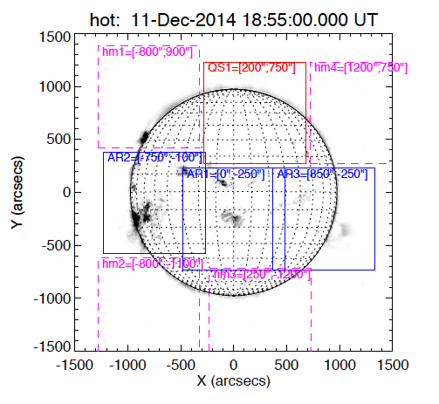
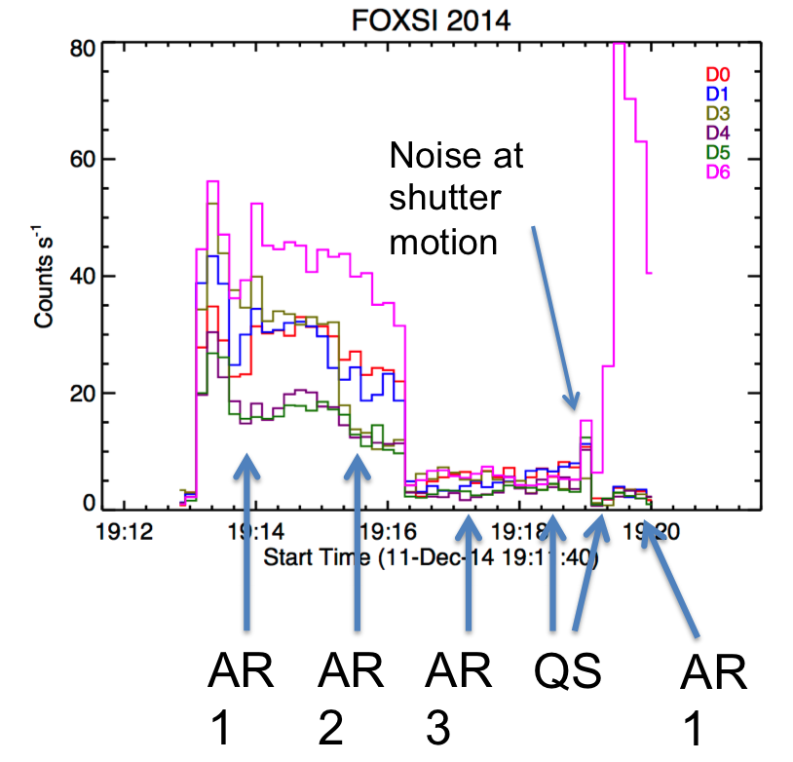
Pointing plan
Sequence (20-100 sec on each):
AR1
AR2
AR3
QS1
QS1 (shutter in)
AR1 (shutter in)
D6 has highest area (3 extra shells) and no shutter.

Slide 3
RHESSI time profile
Microflares

Slide 4
First target: 2 active regions (log scale)
Det0
Det1
Det4
Flare in progress
Det5
Det6
5 Si detectors added together
38.5 sec integration

Slide 5
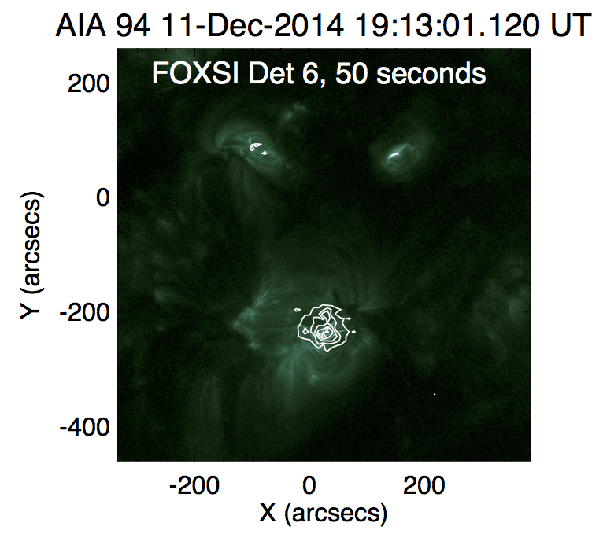
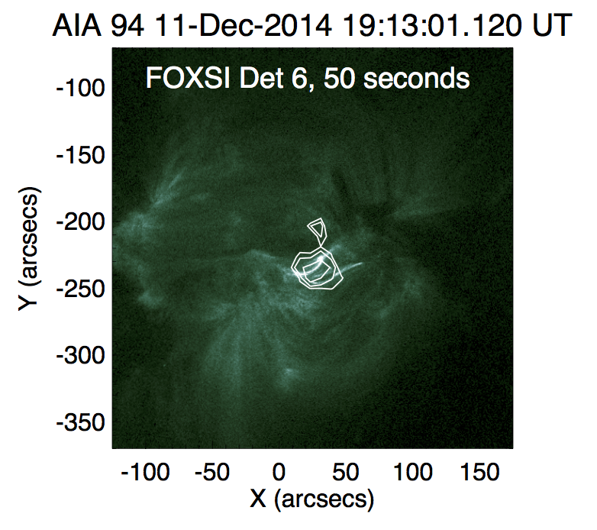
Detector 6 alone, with AIA 94A
Sources are lined up by eye for now.

Slide 6
Third target: southwest limb
35.2 sec integration

Slide 7
Fourth target: Quiet Sun
64.5 sec integration
Not clear if this is single bounce.

Slide 8
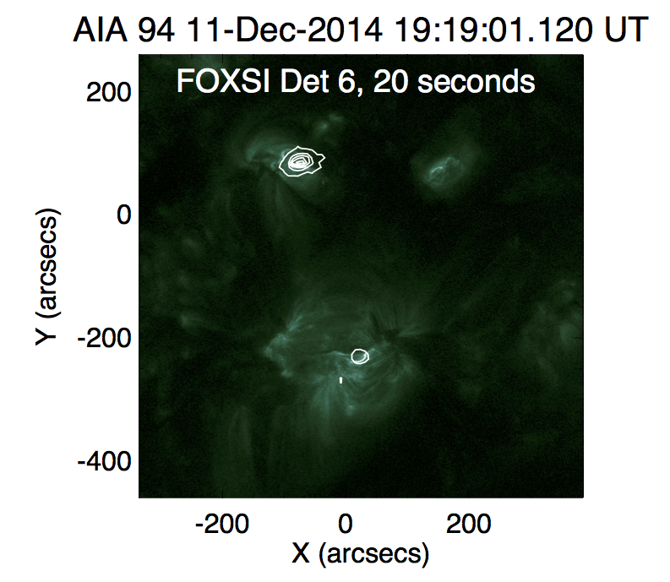
Last target: same as first
Now this guy’s flaring.
32.7 sec integration

Slide 9
Decaying limb flare and NuSTAR/FOXSI observations
NuSTAR

Slide 10
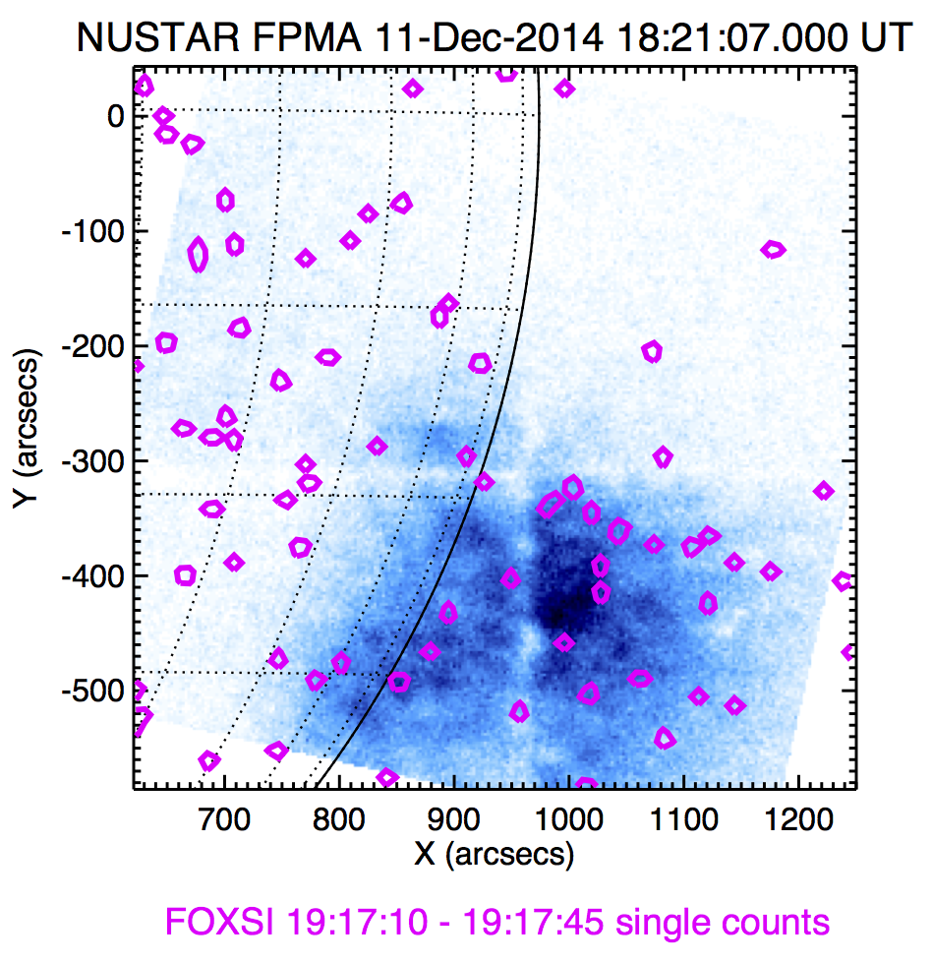
AR at SW limb

Slide 11
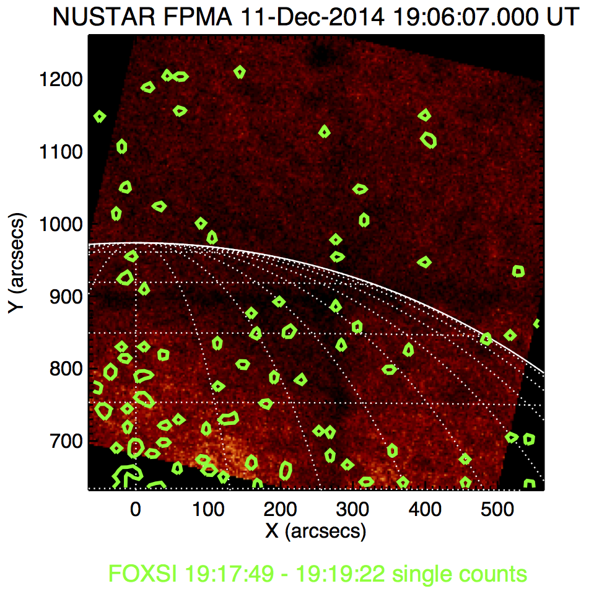
Quiet Sun region

